Slide 1
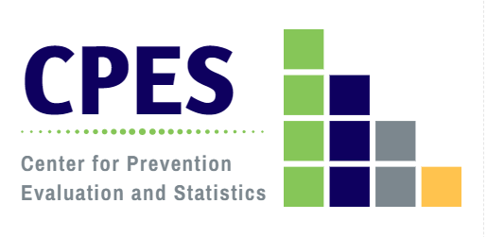
Assessment of Connecticut’s Readiness and Capacity to Implement Mental Health Promotion and Suicide Prevention Activities: Results of the Newly Expanded 2020 Community Readiness Survey (CRS 2020)
CT Suicide Advisory Board
Data to Action Subcommittee Meeting
Monday, January 25, 2021
Jennifer Sussman
DMHAS Center for Prevention Evaluation and Statistics (CPES)
at UConn Health
Notes:
The purpose of this presentation is to provide a background about the opioid epidemic both nationally and in CT. I will present data drawn from the National Survey of Drug Use and Health (NSDUH) which is our best source of ongoing information about problem substance use trends and patterns, as well as local data to the extent possible to flesh out the picture for CT. A few words about the NSDUH survey – it is conducted annually and is based on personal interviews with a representative sample of civilian households in the US. Certain populations are not included: military personnel, institutionalized persons (incarcerated, people in nursing homes, hospitals, etc) and the homeless not living in shelters. State-specific data are available based on bi-annual estimates although national data are reported annually. Approximately 67,000 persons are interviewed each year.
In addition to prescription pain reliever misuse and heroin use, I will also look at the consequences of opioid misuse, in particular with regard to substance use disorder, treatment and mortality.

Slide 2
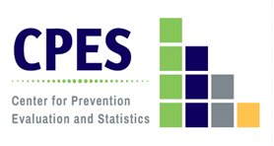
What is the Community Readiness Survey (CRS)?
A biennial key informant survey, conducted since 2006, to assess community-level attitudes, capacity, and readiness to implement prevention/health promotion activities relevant to behavioral health;
A joint collaboration between the Connecticut Department of Mental Health and Addiction Services (DMHAS), the Regional Behavioral Health Action Organizations or RBHAOs (formerly the Regional Action Councils/RACs), the University of Connecticut Department of Public Health Sciences, Wheeler Clinic, and the Connecticut Clearinghouse;
Key informants identified regionally by the RBHAOs, with personalized outreach conducted by RBHAOs and DMHAS prevention partners;
Results at the state and regional levels are used to inform planning, leverage resources, and inform ongoing prevention efforts.

Slide 3
Community Readiness Survey (CRS) Objectives
Assess perceived substance use problems at the local level;
Measure community capacity and readiness for substance misuse prevention and mental health promotion:
Community attitudes about alcohol and drug use, mental health issues, suicide and problem gambling;
Community support for prevention;
Perceived barriers to substance abuse prevention and mental health promotion;
Rating of community readiness;
Develop a tool and methodology that can respond to DMHAS’ ongoing needs assessment, evaluation; and impact assessment needs;
Inform substance abuse prevention and mental health promotion planning at state and regional levels;
Identify stakeholder needs for training and technical assistance.

Slide 4
The 2020 CRS
In response to expansion of DMHAS’ state and regional planning processes to integrate mental health and substance misuse, the CRS 2020 was re-tooled:
The survey was expanded to more fully assess mental health, suicide and gambling attitudes, concerns and readiness;
Items were omitted/consolidated to improve accessibility and reduce survey fatigue;
Added items on problem gambling/gaming/sports betting;
Included parallel questions assessing mental health attitudes, concerns, and capacity;
Added a 9 point mental health promotion readiness scale.
Content changes were informed by a workgroup comprised of: RBHAOs, community prevention partners, and knowledgeable staff from DMHAS, UConn Health/CPES, and the CT Clearinghouse;
Revision of the survey was a data driven process, informed by item analyses, reliability and validity assessment, and scale testing, conducted by the CPES data team.

Slide 5
The 2020 CRS Approach
DMHAS’ Regional Behavioral Health Action Organizations (formerly Regional Action Councils) identified 5-10 key informants per town/city to complete the survey;
5-6 in communities with populations <40K
7-10 in communities with populations 40K+
RBHAOs conducted targeted outreach and follow up with key informants to encourage participation and maximize responses;
DMHAS prevention partners also supported outreach efforts to key informants;
This approach resulted in:
1236 responses to the 2020 CRS survey statewide, a 60% response rate based on the established key informant survey sample;
Representation in 166 (98%) of 169 Connecticut communities;
Response goals met in 117 (69%) communities statewide
91 with population < 40,000 (63.6%)
26 with population 40,000+ (100%)
Notes:
Missing Andover, Hampton and East Granby
Insert response rate: ~60%

Slide 6
Key Informant Stakeholder Affiliation: Connecticut CRS, 2020
* Personal or family experience with mental illness, substance misuse, or problem gambling
** Includes: advocate, community member, municipality, philanthropic organization, non-profit, business
Notes:
Unweighted percents
Respondents spanned 18 sectors. Not mutually exclusive

Slide 7
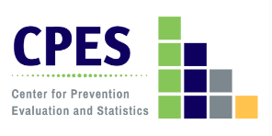
Key Informant Demographic Characteristics: Connecticut CRS, 2020
n=1236
Age
Gender
Race
Notes:
Unweighted percents

Slide 8
Community Type: The Five Connecticuts
The Five Connecticuts are a system developed in 2004 by the Connecticut State Data Center as a means of disaggregating Connecticut’s 2000 census data in a meaningful way.
Five Connecticuts designations are based on criteria of each town:
median household income;
population density; and
poverty rate
Five Connecticut community types:
Wealthy
Suburban
Urban Periphery
Urban Core
Rural
These categories were updated, using the 2010 census data, in 2014, by the original developer of the designation. The updated designations have been used to categorize data for the Community Wellbeing Surveys since 2015, and the 2018 and 2020 Community Readiness Survey, and are used by others as well.
Levy, Don and DataHaven. (2015): Five Connecticuts 2010 Update. Produced for Siena College Research Institute and DataHaven based on the original method of assigning designations used in Levy, Don, Orlando Rodriguez, and Wayne Villemez. 2004. The Changing Demographics of Connecticut - 1990 to 2000. Part 2: The Five Connecticuts. Storrs, Connecticut: University of Connecticut SDC Series, no. OP 2004-01.

Slide 9
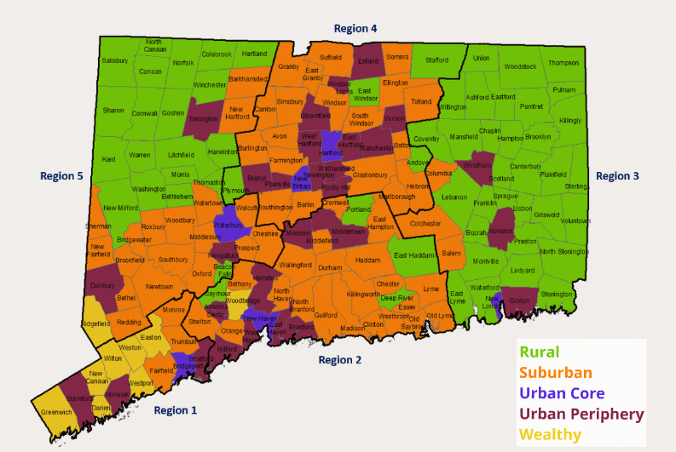
Community Types in Connecticut: The Five Connecticuts (5CT)
CPES, 2019

Slide 10
Mental Health Issue of Greatest Concern for Age Groups, According to Key Informants: Connecticut CRS, 2020
Notes:
Weighted percents

Slide 11
Mental Health Issue of Greatest Concern for Youth and Young Adults, by Community Type, According to Key Informants: Connecticut CRS, 2020
12-17
Notes:
Weighted percents

Slide 12
Community Attitudes Toward Mental Health: Connecticut CRS, 2020
*Urban Core ranks significantly higher than all other community types. Wealthy ranks significantly lower than all other community types.
**Urban Core ranks significantly lower than all other community types.
***Urban Core ranks significantly higher than R, S, and UP. Wealthy ranks significantly higher than R and UP.
Key Informant believes that most community residents ….
Notes:
Weighted means

Slide 13
Perceived Barriers/Assets to Mental Health Promotion Activities in the Community: Connecticut CRS, 2020
Analyses found significant differences by community type for all barriers/assets except “a strategic plan to address mental health needs.”
Notes:
Weighted percents. Analyses found significant differences by community type for all barriers/assets except “a strategic plan to address mental health needs.”

Slide 14
Community Support for Suicide Prevention Efforts: Connecticut CRS, 2020
Notes:
TEST: Kruskal-Wallis/Mann – Whitney U (to detect differences between groups)

Slide 15
Community Ability to Implement Suicide Prevention Efforts: Connecticut CRS, 2020
Notes:
TEST: Kruskal-Wallis/Mann – Whitney U (to detect differences between groups)

Slide 16
Key Informant Ratings of Suicide Prevention Supports in Place in the Community: Connecticut CRS, 2020
Analyses found significant differences by community type for key informant ratings for all supports.
Key Informant believes that the following are in place in the community….
Notes:
Weighted means

Slide 17
Community Readiness to Undertake Behavioral Health Promotion Activities*: Connecticut CRS, 2020
Analyses found significant differences by community type for activities except data collection.
Key Informant believes that the community is ready to….
*Behavioral Health Promotion Activities includes substance misuse prevention and mental health promotion activities.
Notes:
Weighted means

Slide 18
Key Informant Ratings of the Community Stage of Readiness for Mental Health Promotion : Connecticut CRS, 2020
Community Stage of Readiness for Mental Health Promotion: Connecticut (n=895) | Percent
1 - This town/city is unsupportive of those with mental health issues. | .9
2 - This town/city has little or no recognition of the community’s concern about mental health. | 5.7
3 - This town/city believes that mental health concerns impact the community, but awareness of the issue is only linked to one or two situations involving mental health. | 13.4
4 - This town/city recognizes the mental health concerns of the community and leaders on the issue are identifiable, but little planning has been done to address problems and risk factors. | 31.8
5 - This town/city is planning for mental health promotion programs and focuses on practical details, including seeking funds for awareness efforts. | 19.8
6 - This town/city has enough information to justify a mental health promotion program and there is great enthusiasm for the initiative as it begins. | 7.0
7 - This town/city has created policies and/or more than one mental health promotion program is running with financial support and trained staff. | 7.8
8 - This town/city views standard mental health promotion programs as valuable, new programs are being developed to reach out to at-risk populations and there is ongoing sophisticated evaluation of current efforts. | 8.9
9 - This town/city has detailed and sophisticated knowledge of prevalence, risk factors, and mental health promotion program effectiveness and the programming is tailored by trained staff to address risk factors within the community. | 4.6
Mean Stage of Readiness for Connecticut | 4.88
Notes:
DMHAS regional ratings ranged from 4.86 (R1) to 5.00 (R2). 5CT community type ratings ranged from 4.35 (R) to 5.37 (UP).

Slide 19
Key Informant Ratings of the Community Stage of Readiness for Mental Health Promotion, by Community Type: CRS, 2020
*Urban Periphery communities rank significantly higher than Urban Core, Suburban, and Rural, F=10.770, p=.000
Notes:
Test: ANOVA. 4 - This town/city recognizes the mental health concerns of the community and leaders on the issue are identifiable, but little planning has been done to address problems and risk factors.
5 - This town/city is planning for mental health promotion programs and focuses on practical details, including seeking funds for awareness efforts.
6 - This town/city has enough information to justify a mental health promotion program and there is great enthusiasm for the initiative as it begins.

Slide 20
Conclusions
Statewide, anxiety and depression are the mental health issues of greatest community concern according to key informants, with shifts from anxiety to depression as age group increases.
Connecticut’s community readiness is situated between identification/recognition of the mental health concerns of the community and its leaders, and practical, detailed planning, including seeking funds for awareness efforts.
According to the CRS 2020 results, communities differed by type in:
Attitudes/perceptions about mental health and suicide
Perceived barriers/assets
Community readiness to undertake specific behavioral health activities
Perceptions of supports in place in their communities; and
Overall readiness to implement mental health promotion.
Community type is an important factor in assessment of community readiness and capacity for implementation of mental health promotion and suicide prevention.

Slide 21
Next Steps
Conduct additional analyses by subgroup to assess factors driving community type differences;
Create community type readiness and capacity profiles based on CRS 2020 profiles;
Unpack community type differences with stakeholders to assess validity of these findings in the field;
Pair CRS 2020 data with other public health data to determine community and contextual factors impacting behavioral health capacity and readiness.
Conduct 2022 Community Readiness Survey to begin to assess change and document trends in community behavioral health readiness and capacity.
“Never doubt that a small group of thoughtful, committed citizens can change the world; indeed, it’s the only thing that ever has.” ~ Margaret Mead

Slide 22
For more information, contact Jennifer Sussman: sussman@uchc.edu
Visit the SEOW Prevention Data Portal at: https://preventionportal.ctdata.org/

